Slide 1


Statistic
Lecture 2
Dr. Nada Abdullah Rasheed
Assist prof. / Computer Science

Slide 2
Syllabus Content
Subject | Lec. No.
Frequency Distributions and Graphing | 3
Continuous vs. Discrete Data | 4
Frequency Distributions for Quantitative Variables: | 6

Slide 3
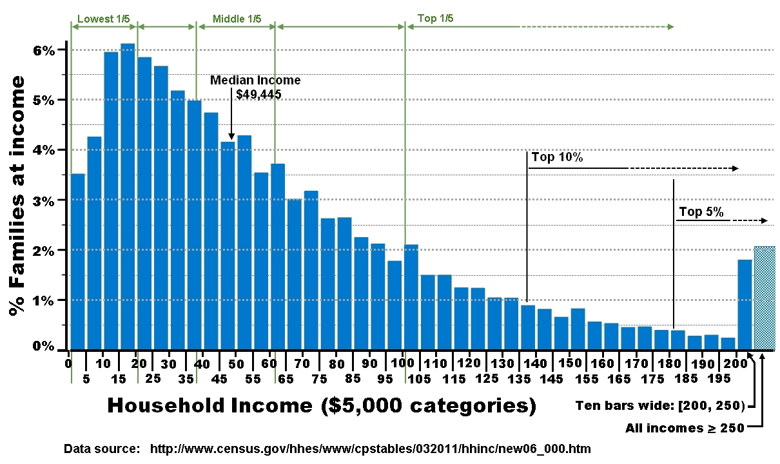
Frequency Distributions and Graphing
This chapter addresses some of the basic uses of statistics that is, organizing and summarizing data through frequency distributions and graphing. Before discussing these topics, some other issues must first be addressed that deal with types of data, which has implications for how data are organized and graphed.

Slide 4
Frequency Distributions and Graphing
2.1 Continuous vs. Discrete Data:
For quantitative data that has been measured on an interval or a ratio scale, the data can be continuous or discrete. Continuous data have a theoretically infinite number of possible values between any two measurable points, that is, the data are assumed to continue infinitely between any two measurable values, so a measurement that contains a decimal or is a fraction of a whole number makes sense. For example, between 1 second and 2 seconds there can be 1.02 seconds, 1.156 seconds, 1.5432678 seconds, etc.

Slide 5
Frequency Distributions and Graphing
discrete data there are a finite or fixed number of values that can exist between any two measurable points; hence, decimals and fractions of measurable numbers do not make sense. For example, one row of desks in a classroom may contain 2 students and a second row may contain 4 students.

Slide 6
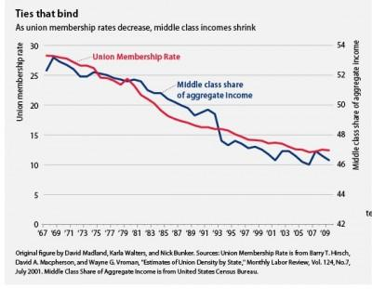
Frequency Distributions and Graphing
2.2 Frequency Distributions for Quantitative Variables:
When data are collected, they are unorganized, and one of the basic uses of statistics is to organize raw data. The graph below is an example of raw data can be consolidated into a simple figure to express information. This chapter is concerned with taking unorganized raw pieces of information and organizing them into something meaningful.

Slide 7
Frequency Distributions and Graphing
A frequency distribution is data that have been organized into a table or a graph. In table form each value or level of a variable is listed with the number of times that value or level appeared in the data. As a graph, each value of the level of the variable is presented as a function of the number of times that value or level occurred in the data. Frequency distributions simply consolidate a data set into something smaller and manageable. Generally, frequency distribution table (or simply frequency table) refers to a frequency distribution in table form; whereas frequency distribution refers to one in graphed form.

Slide 8
Frequency Distributions and Graphing
There is a limitation to listing absolute frequencies as these don't tell you anything about the rest of the distribution, that is, absolute frequencies don’t tell you how frequent a value occurred relative to the rest of the distribution.
We need a standard measure that tells us of the frequency of a value relative to the distribution such that higher values indicate a higher impact and lower values indicate a lesser impact. This is the relative frequency (rf) is the proportion of times each value occurred in the data.

Slide 9
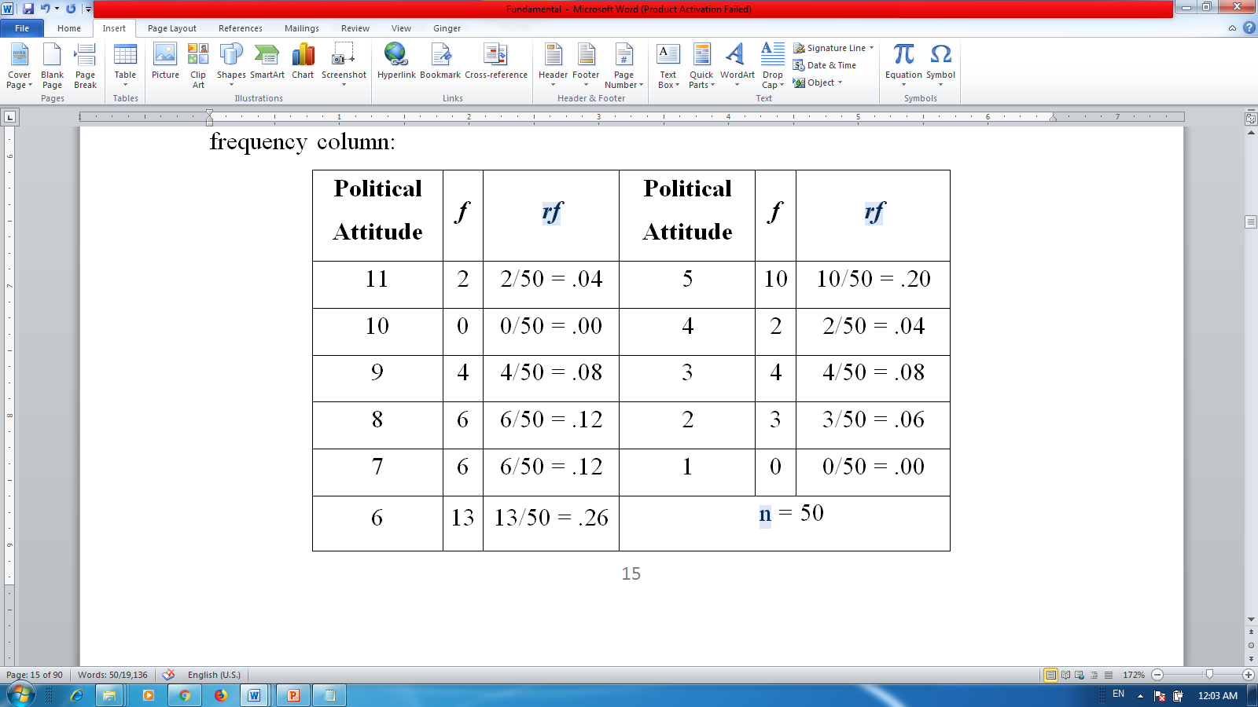
Frequency Distributions and Graphing

Slide 10
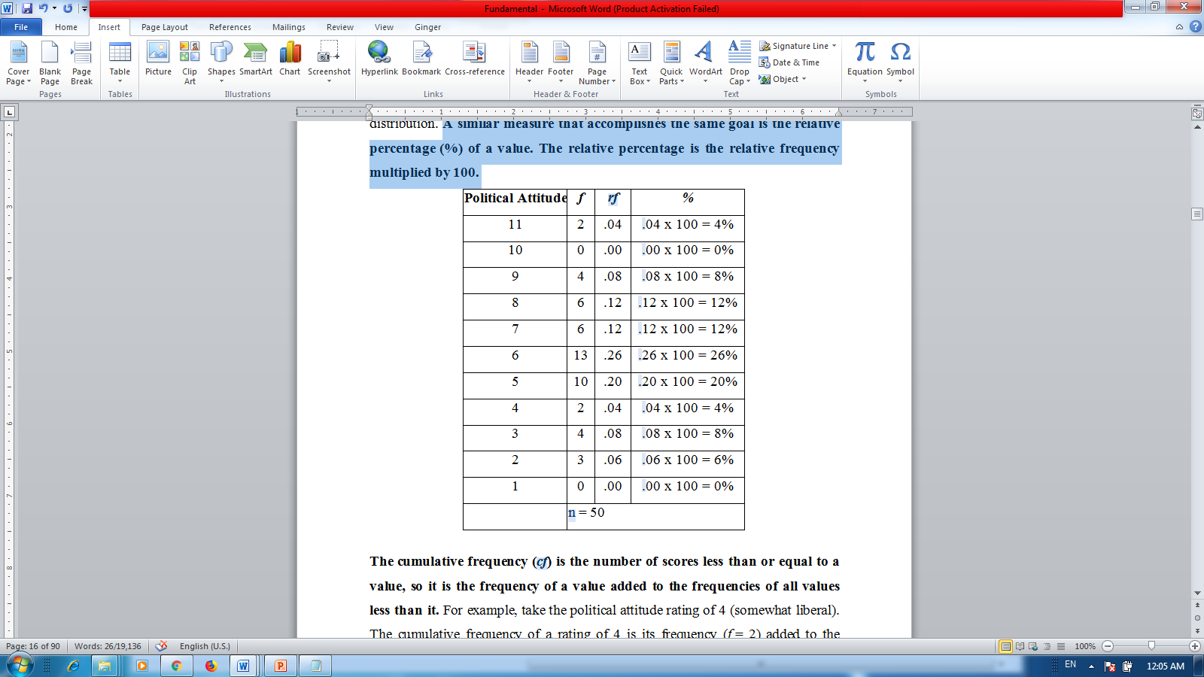
Frequency Distributions and Graphing
A similar measure that accomplishes the same goal is the relative percentage (%) of a value. The relative percentage is the relative frequency multiplied by 100.

Slide 11
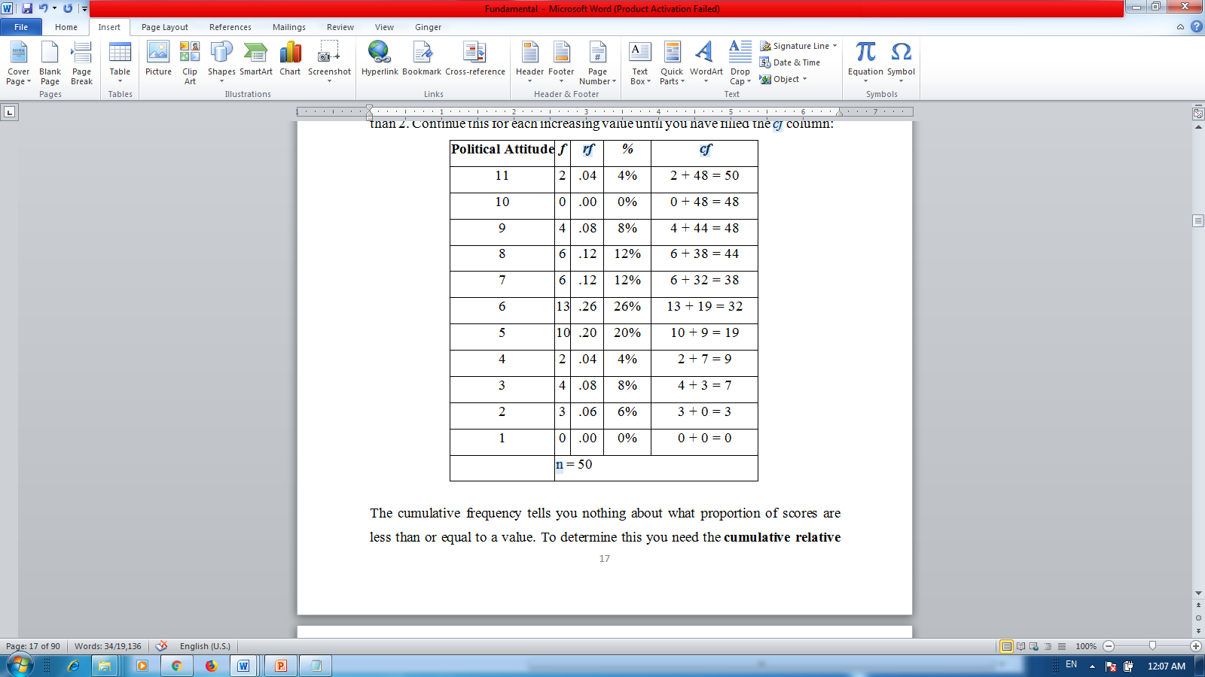
Frequency Distributions and Graphing
The cumulative frequency (cf) is the number of scores less than or equal to a value, so it is the frequency of a value added to the frequencies of all values less than it.

Slide 12
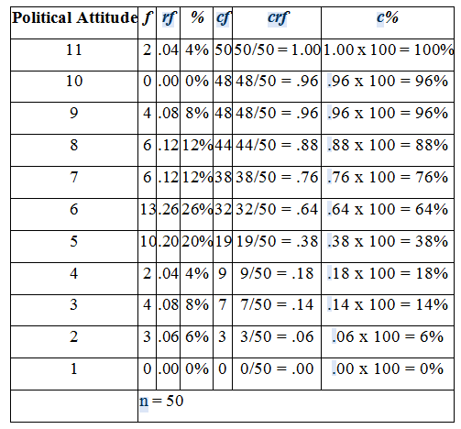
Frequency Distributions and Graphing

